Slide 1
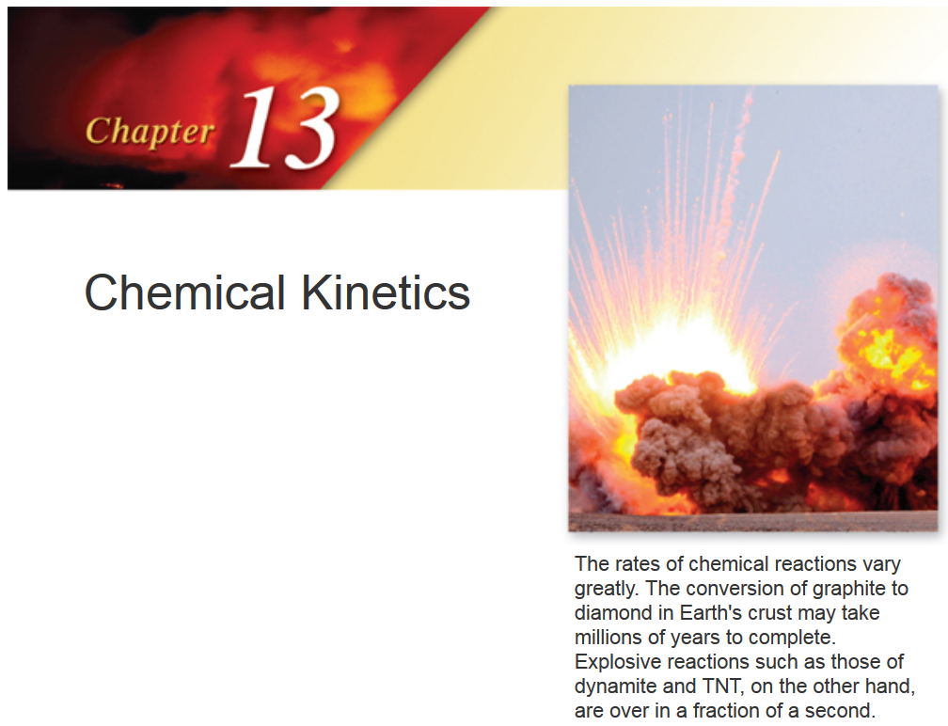

Slide 2
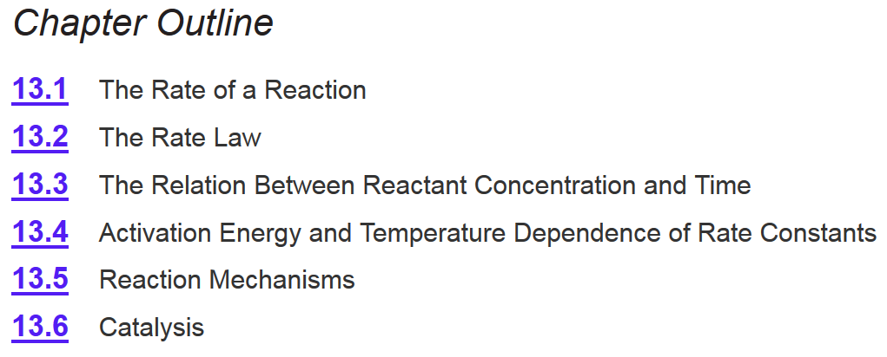
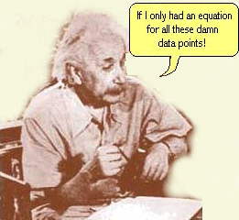
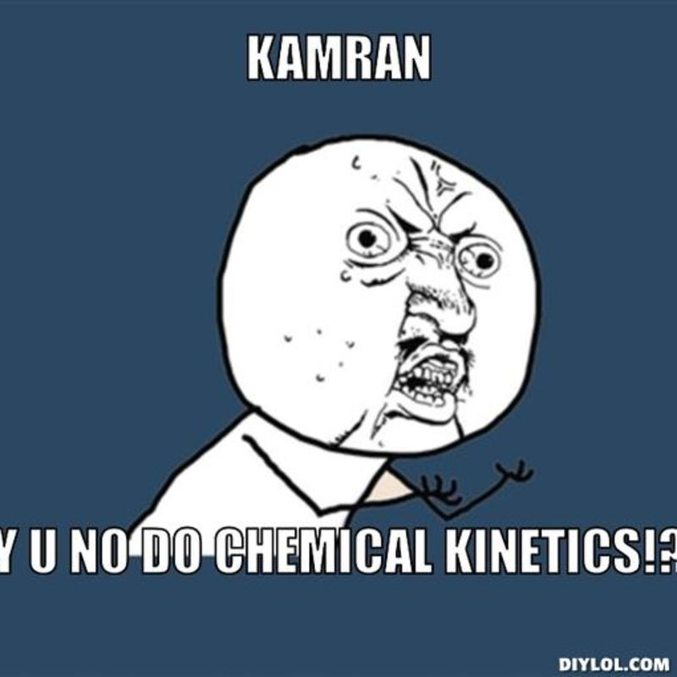
Chapter 13
Ch 13
Page 564

Slide 3
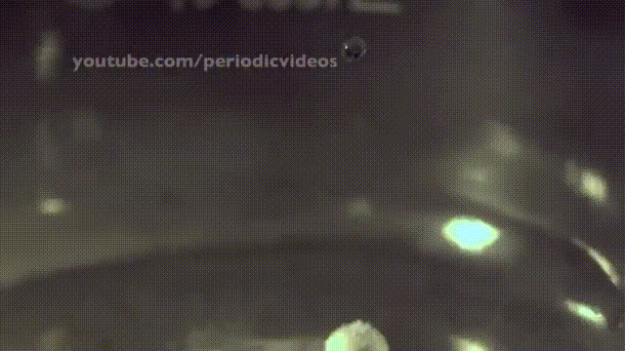
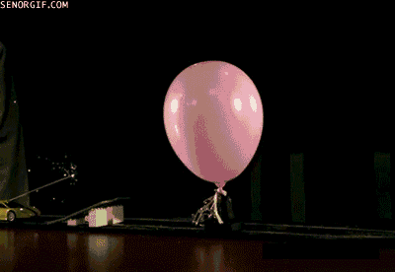
Chemical Reactions
A B
Alkali metals react violently with water
2Na + 2H₂O ⎯→ 2NaOH + H₂
H₂ and O₂ do not react under normal conditions, but can react explosively from one spark
2H₂ + O₂ ⎯→ 2H₂O

Slide 4
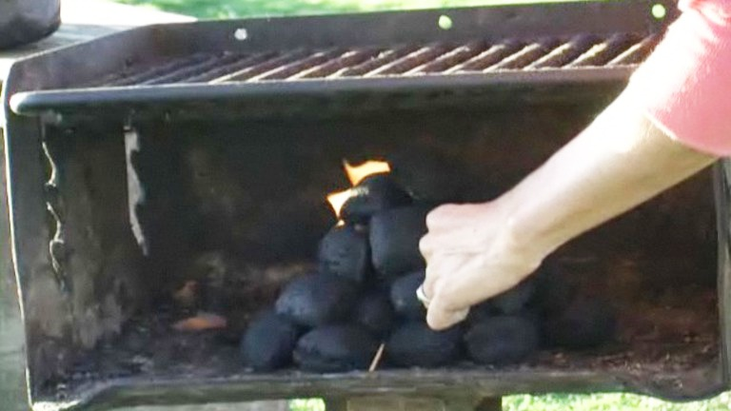
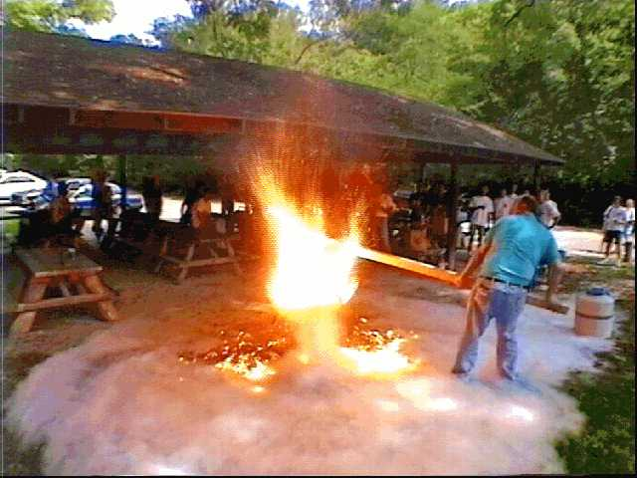
Chemical Kinetics
Starting a grill.
Starting a grill w/ liquid O₂.
Factors to be considered:
  Concentrations of the reactants
  Physical state of the reactants
  Temperature
  Time
All influence the rate of a reaction

Slide 5
Reaction Rate
Thermodynamics (CH 6) – does a reaction take place?
Kinetics – how fast does a reaction proceed?
The reaction rate is defined as the change in concentration per unit of time:
C_{f} and C_{i} – concentration of the starting reactant at times t_{f} and t_{i}, respectively (t_{f} > t_{i})
Ch 13.1
Page 565

Slide 6
Chemical Kinetics
Reaction rate is the change in the concentration of a reactant or a product with time (M/s).
A B
Δ[A]
Δ[A] = change in concentration of A over
time period Δt
rate = -
Δt
Δ[B]
Δ[B] = change in concentration of B over
time period Δt
rate =
Δt
Because [A] decreases with time, Δ[A] is negative.

Slide 7
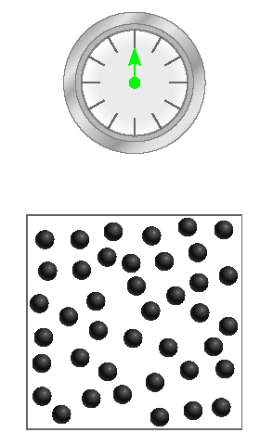
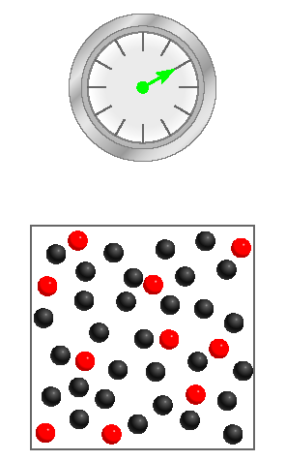
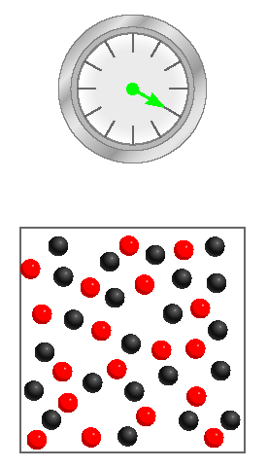
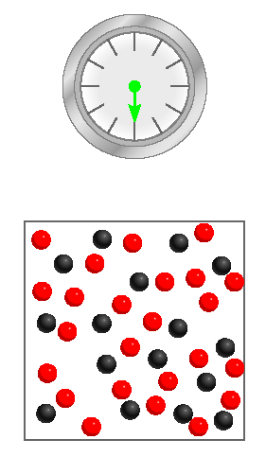
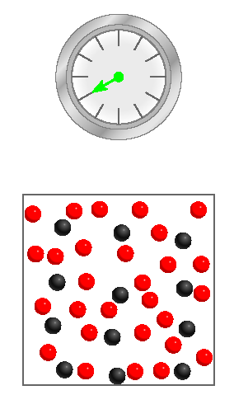
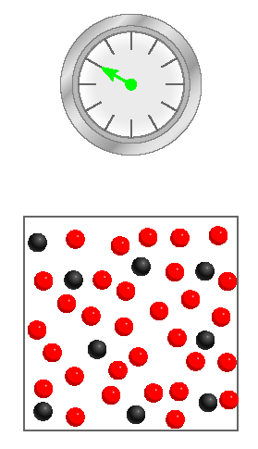
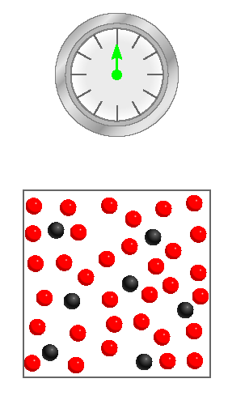
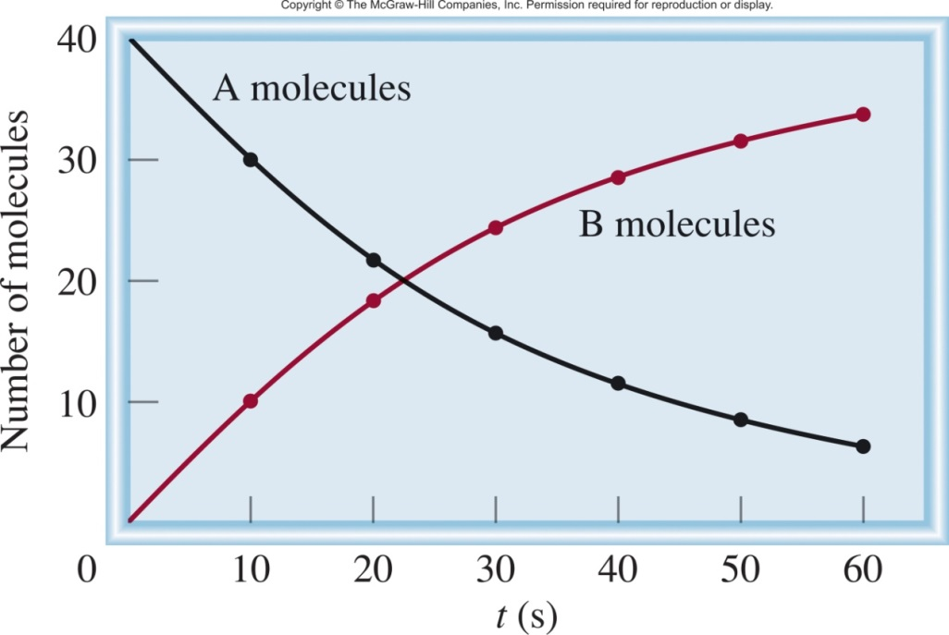
A B
10 red
18 red
24 red
28 red
31 red
33 red
Δ[A]
rate = -
Δt
Δ[B]
rate =
Δt

Slide 8
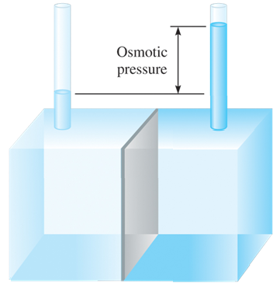
Osmotic Pressure
Osmosis is a rate controlled phenomenon.
  The solvent is passing from the dilute solution into the concentrated solution at a faster rate than in opposite direction, i.e. establishing an equilibrium.
The osmotic pressure
https://www.youtube.com/watch?v=T00KVPpLNGQ

Slide 9
Chapter 13
Ch 13
Page 564

Slide 10
Chemical Kinetics
Reaction rate is the change in the concentration of a reactant or a product with time (M/s).
A B
Δ[A]
Δ[A] = change in concentration of A over
time period Δt
rate = -
Δt
Δ[B]
Δ[B] = change in concentration of B over
time period Δt
rate =
Δt
Because [A] decreases with time, Δ[A] is negative.

Slide 11
Reaction Rates and Stoichiometry
A B
One mole of A disappears for each mole of B that is formed.
Δ[A]
Δ[B]
rate = -
rate =
Δt
Δt
2C D
Two moles of C disappear for each mole of D that is formed.
Δ[C]
Δ[D]
2 x rate = -
rate =
Δt
Δt
or
1
Δ[C]
Ch 13.1
Page 571
rate = -
2
Δt

Slide 12
General Reaction Rate Expression
For a general reaction:
the reaction rate can be expressed as
aA + bB ⎯→ cC + dD
Ch 13.1
Page 571

Slide 13
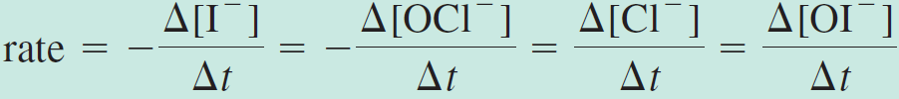
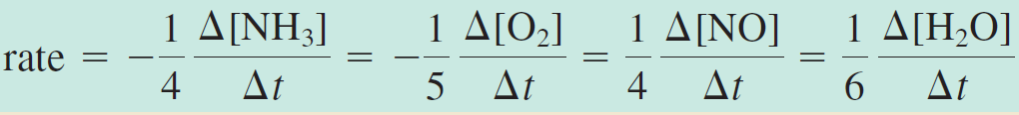
13.1
Write the rate expressions for the following reactions in terms of the disappearance of the reactants and the appearance of the products:

Slide 14
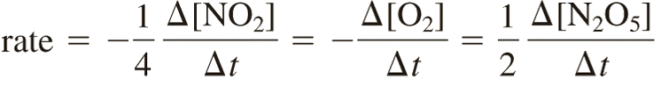
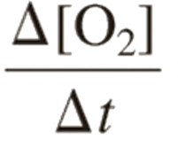
13.2
Consider the reaction
Suppose that, at a particular moment during the reaction, molecular oxygen is reacting at the rate of 0.024 M/s.
At what rate is N₂O₅ being formed?
At what rate is NO₂ reacting?
1) Write the reaction rate for each species:
2) Know the oxygen reaction rate:
=
-0.024 M/s
3) Do algebra:

Slide 15


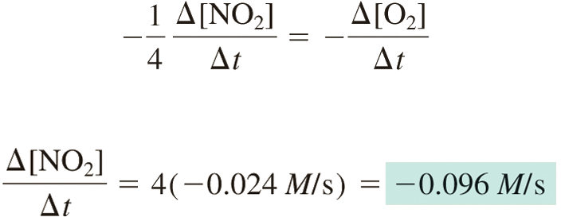
13.2
=
-0.024 M/s
For [N₂O₅]:
For [NO₂]:

Slide 16
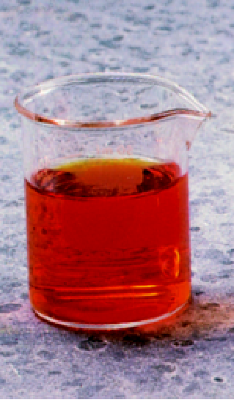
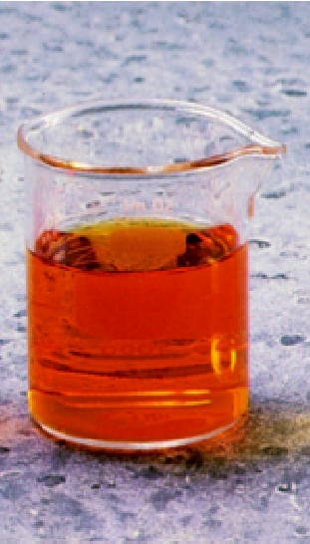
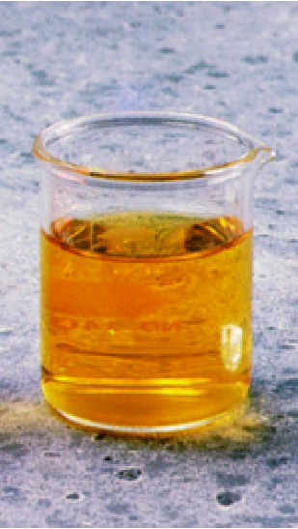
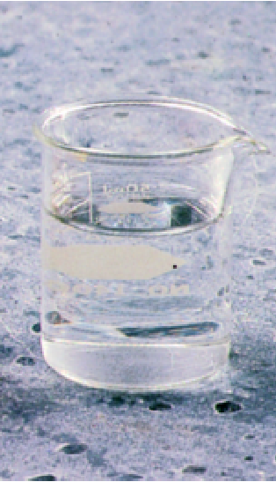
Experimental Determination of Rates
red-brown
Colorless
Br₂ (aq) + HCOOH (aq) 2Br⁻ (aq) + 2H⁺ (aq) + CO₂ (g)
Time
Δ[color]
rate = -
Δt

Slide 17

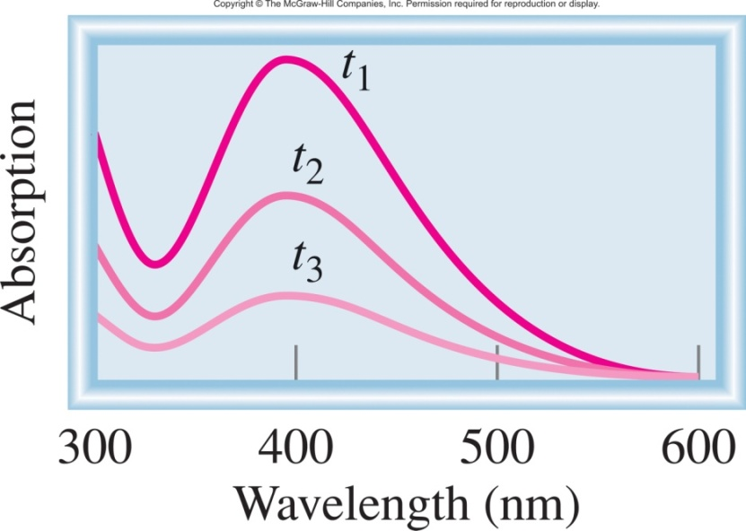
Experimental Determination of Rates
Br₂ (aq) + HCOOH (aq) 2Br⁻ (aq) + 2H⁺ (aq) + CO₂ (g)
time
393 nm
Detector
light
Δ[Br₂] α Δ Absorption

Slide 18

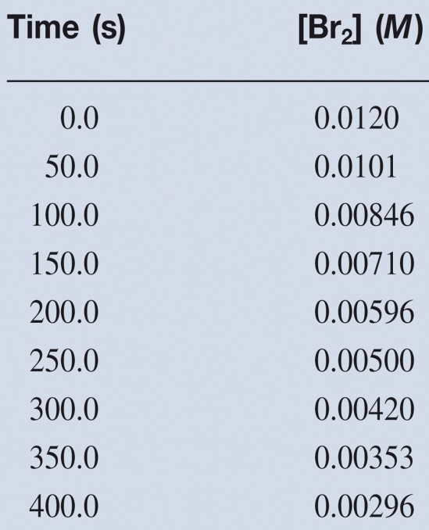
Experimental Determination of Rates
Br₂ (aq) + HCOOH (aq) 2Br⁻ (aq) + 2H⁺ (aq) + CO₂ (g)
Δ[Br₂] α Δ Absorption
Calculate Rate:
Δ[Br₂]
[Br₂]_{final} – [Br₂]_{initial}
rate = -
= -
Δt
t_{final} - t_{initial}

Slide 19
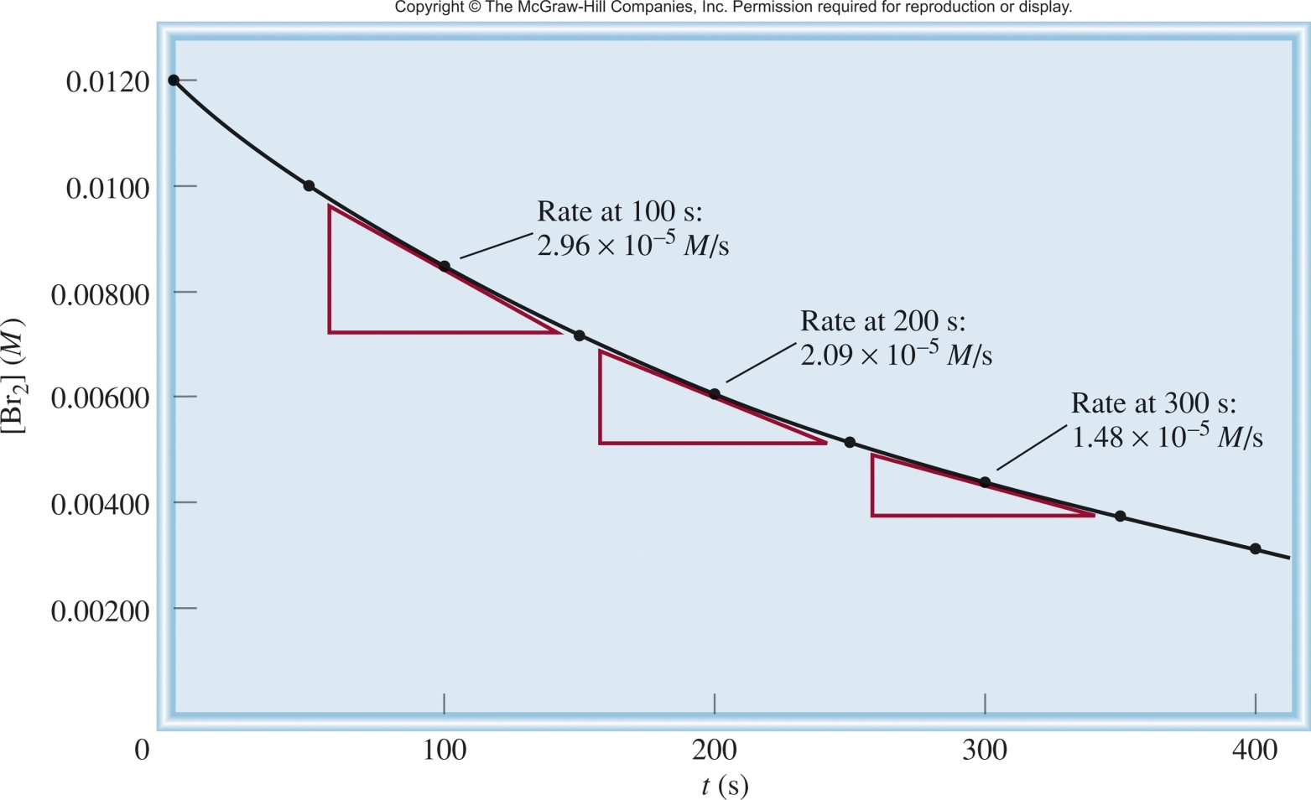
Experimental Determination of Rates
Rate changes with [conc]
rate α [Br₂]
We need a better way to describe the rate!
slope of
tangent
slope of
tangent
slope of
tangent
Δ[Br₂]
[Br₂]_{final} – [Br₂]_{initial}
rate = -
= -
Δt
t_{final} - t_{initial}
instantaneous rate = rate for specific instance in time

Slide 20
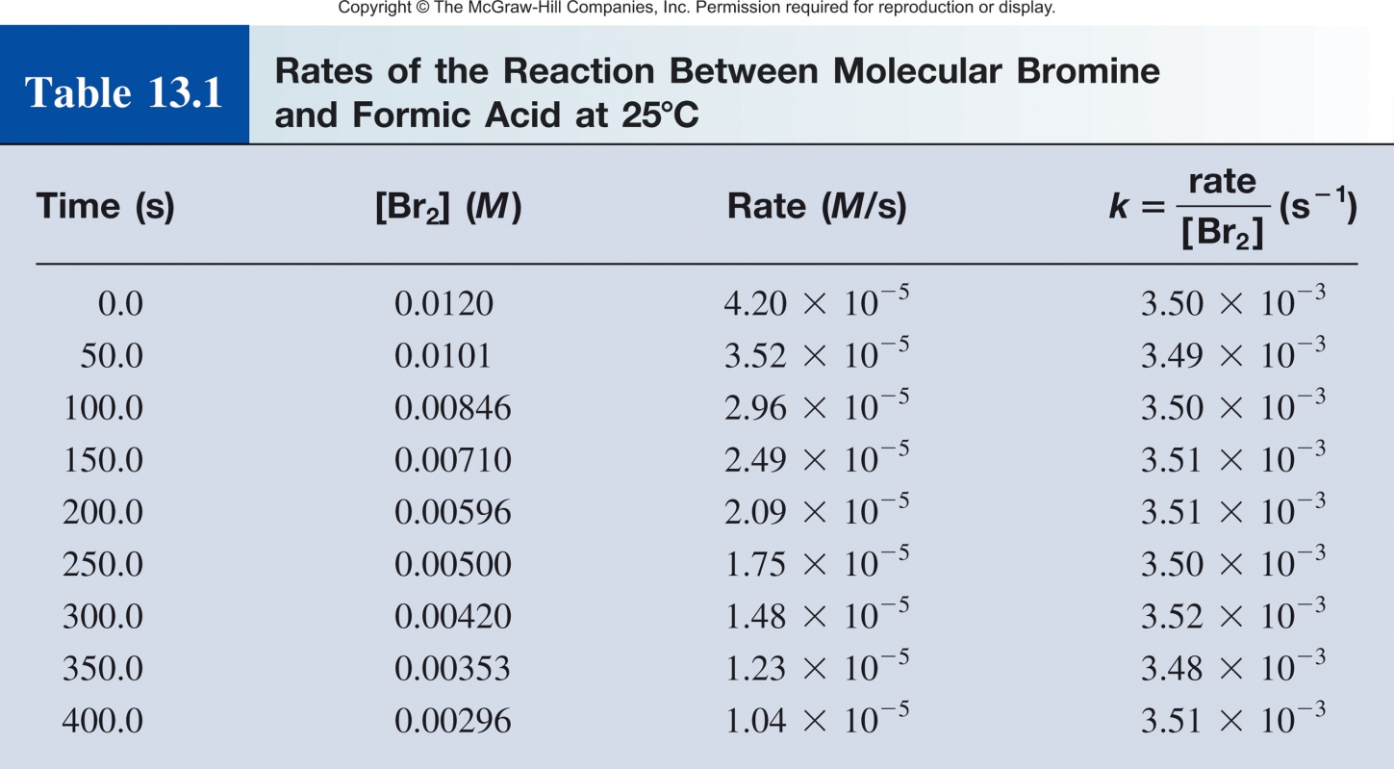
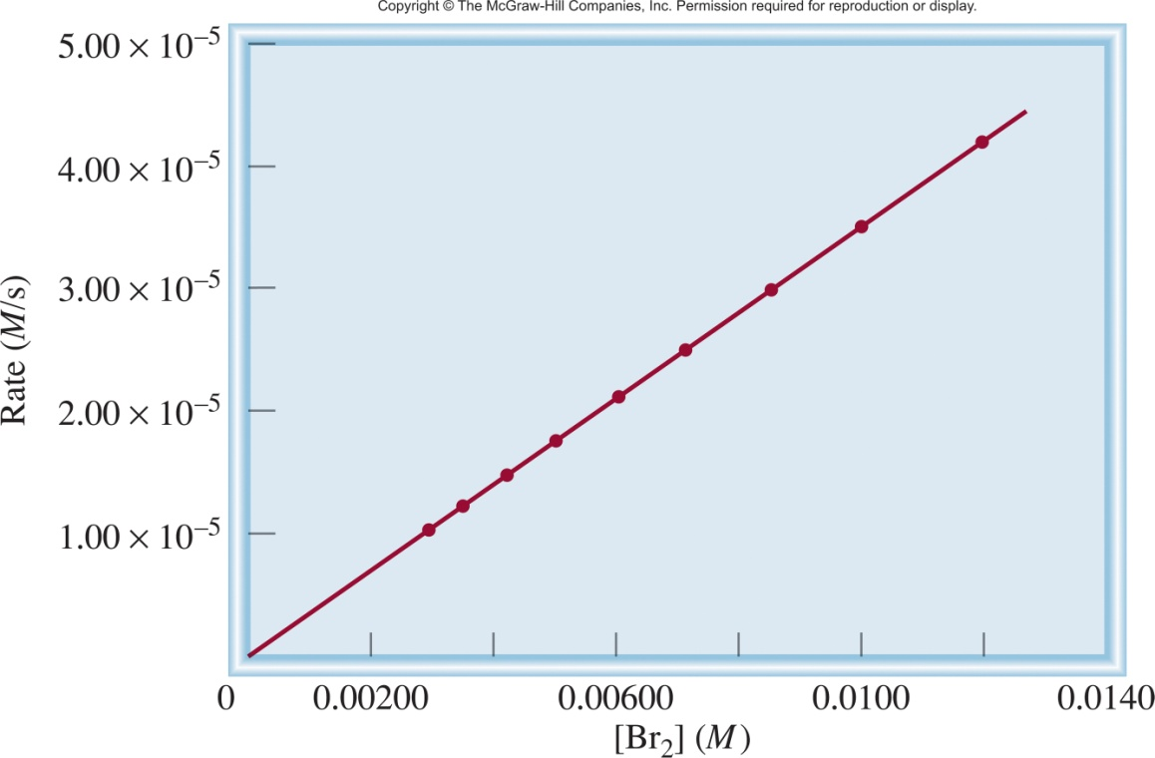
Experimental Determination of Rates
rate α [Br₂]
rate = k [Br₂] + 0
rate
k =
= rate constant
[Br₂]
= 3.50 x 10⁻³ s⁻¹
rate constant- constant of the proportionality between the reaction rate and the concentration of reactant.
General descriptor for the rate of a reaction that is independent of [conc].

Slide 21
Chapter 13

Slide 22
Rate Law
Br₂ (aq) + HCOOH (aq) 2Br⁻ (aq) + 2H⁺ (aq) + CO₂ (g)
rate α [Br₂]
Can describe the rate of a complex reaction with one simple equation that is dependent on a few reactants, using the Rate Law!
rate = k [Br₂]
The rate law expresses the relationship of the rate of a reaction to the rate constant and the concentrations of the reactants raised to some powers.
aA + bB ⎯→ cC + dD
The rate law for a general reaction takes the form:
Ch 13.2
Page 573

Slide 23
Rate Law
aA + bB ⎯→ cC + dD
The rate law for a general reaction takes the form:
Reaction order is “always” defined in terms of reactant (not product) concentrations.
x and y are the order of the reaction.
The power coefficients x and y are not the same as the stoichiometric coefficients a and b.
Rate laws (x and y, and reactants involved) are “always” determined experimentally.

Slide 24
Reaction Order
aA + bB ⎯→ cC + dD
The rate law for a general reaction takes the form:
Reaction order- specify the relationship between the concentrations of reactants A and B and the reaction rate.
Reaction is xth order in A
Reaction is yth order in B
Reaction is (x +y)th order overall
If a reagent is zero order it is not included in the rate law.
Helps to explain the mechanism of the reaction. Order tells you what molecules are involved in the rate limiting step and how of each molecule are needed.
Ch 13.2
Page 573

Slide 25
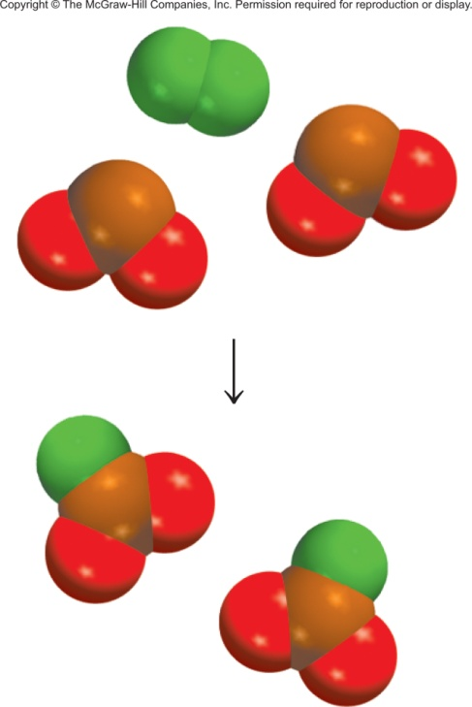
Reaction Order
aA + bB ⎯→ cC + dD
Important Note: he power coefficients x and y are not the same as the stoichiometric coefficients a and b.
F₂ (g) + 2ClO₂ (g) 2FClO₂ (g)
1
rate = k [F₂][ClO₂]
The reaction is rate determined by the collision and reaction of 1 F₂ and 1 ClO₂.
But…when each reaction is complete 2 ClO₂ and 1 F₂ are consumed.

Slide 26
Reaction Order and Rate
How will the rate of the following reaction change when the concentration of NO is (a) doubled? (b) halved, O₂ is (c) doubled? (d) halved?
2NO_{(g)} + O_{2(g)} ⎯→ 2NO_{2(g)}
k is constant, conc and rate changing
Starting condition:
rate = [1]²[1]
= 1
a) NO₂ doubled:
rate = [2]²[1]
= 4
b) NO₂ halved:
rate = [0.5]²[1]
= 0.25
c) O₂ doubled:
rate = [1]²[2]
= 2
d) O₂ halved:
rate = [1]²[0.5]
= 0.5

Slide 27
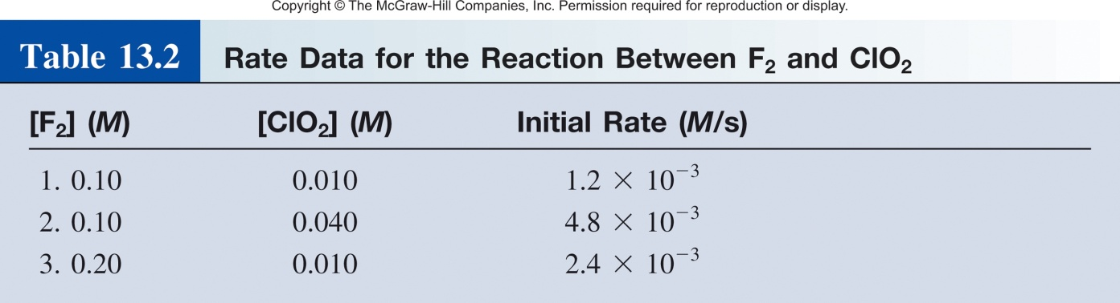
Determining Rate Laws (by inspection)
F₂ (g) + 2ClO₂ (g) 2FClO₂ (g)
Vary concentrations.
Measure rate.
Tabulate the data.
rate = k [F₂]^{x}[ClO₂]^{y}
Comparing rxn 1 and 2:
[F₂] constant, [ClO₂] quadruples, rate quadruples
rate α [ClO₂]
y = 1
Ch 13.2
Page 573

Slide 28
Determining Rate Laws (by inspection)
F₂ (g) + 2ClO₂ (g) 2FClO₂ (g)
Vary concentrations.
Measure rate.
Tabulate the data.
rate = k [F₂]^{x}[ClO₂]^{y}
Comparing rxn 1 and 2:
[F₂] constant, [ClO₂] quadruples, rate quadruples
rate α [ClO₂]
y = 1
Comparing rxn 1 and 3:
[ClO₂] constant, [F₂] doubles, rate doubles
Ch 13.2
Page 573
rate α [F₂]
x = 1

Slide 29
Determining Rate Laws (by inspection)
F₂ (g) + 2ClO₂ (g) 2FClO₂ (g)
Vary concentrations.
Measure rate.
Tabulate the data.
rate = k [F₂]¹[ClO₂]¹
Calculate the rate constant (k)?
Can use any experiment!
rate₁ = 1.2x10⁻³ M/s = k [0.1 M]¹[0.1 M]¹
k = 0.012 M⁻¹ s⁻¹
Measure [conc] over time
find rate law
calculate rate constant

Slide 30
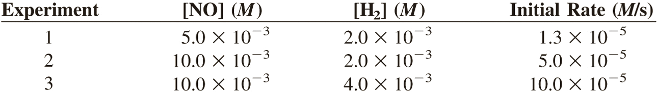
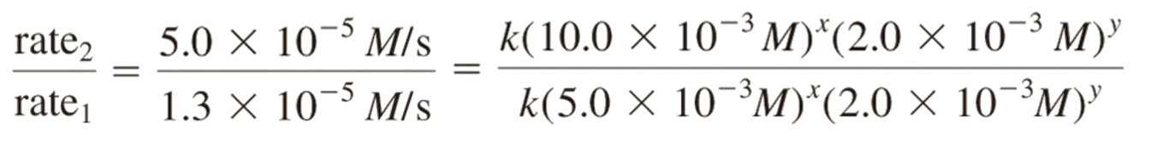
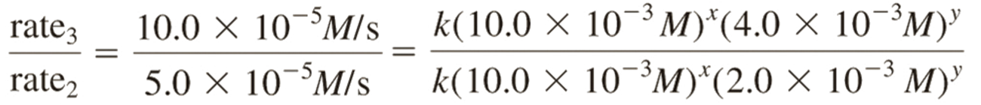
Determining Rate Laws (with Math)
rate = k[NO]^{x} [H₂]^{y}
Ratio of rxn 1 and 2:
x = 2
~4
=
2^{x}
Ratio of rxn 2 and 3:
y = 1
2
=
2^{y}

Slide 31
Practice Problem
The following rate data were obtained at 25°C for the reaction. What isthe rate-law expression and the specific rate-constant for this reaction?
2A_{(g)} + B_{(g)} ⎯→ 3C_{(g)}
Experiment Number | Initial [A] (M) | Initial [B] (M) | Initial rate of formation of C (M/s)
1 | 0.10 | 0.10 | 2.0 x 10⁻⁴
2 | 0.20 | 0.30 | 4.0 x 10⁻⁴
3 | 0.10 | 0.20 | 2.0 x 10⁻⁴
Hint: How does a zero order reagent affect the reaction?

Slide 32
Practice Problem
A chemical reaction between A and B is first order with respect to A, first order with respect to B, and second order overall. From the information given below, fill in the blanks.
Experiment | Initial Rate (M/s) | Initial [A] (M) | Initial [B] (M)
1 | 4.0 x 10⁻³ | 0.20 | 0.050
2 | 1.6 x 10⁻² |  | 0.050
3 | 3.2 x 10⁻² | 0.40

Slide 33
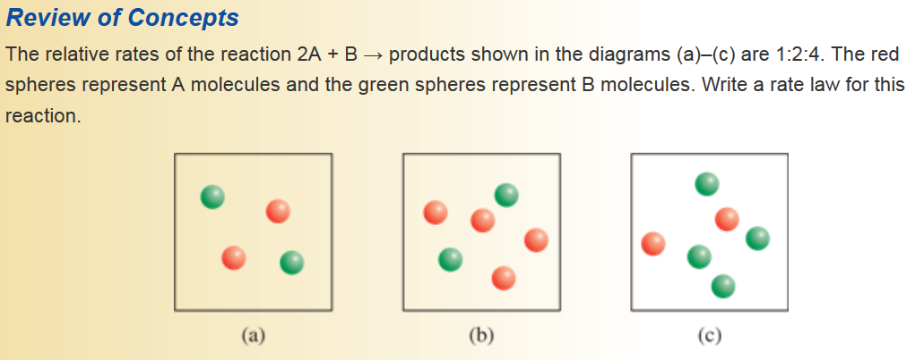
Practice Problem

Slide 34
Chapter 13
Ch 13
Page 564

Slide 35
General Reaction Rate Expression
For a general reaction:
the reaction rate can be expressed as
aA + bB ⎯→ cC + dD
Ch 13.1
Page 571

Slide 36
Determining Rate Laws (by inspection)
F₂ (g) + 2ClO₂ (g) 2FClO₂ (g)
Vary concentrations.
Measure rate.
Tabulate the data.
rate = k [F₂]^{x}[ClO₂]^{y}
Comparing rxn 1 and 2:
[F₂] constant, [ClO₂] quadruples, rate quadruples
rate α [ClO₂]
y = 1
Comparing rxn 1 and 3:
[ClO₂] constant, [F₂] doubles, rate doubles
Ch 13.2
Page 573
rate α [F₂]
x = 1

Slide 37
Chapter 13
Ch 13.3
Page 577

Slide 38
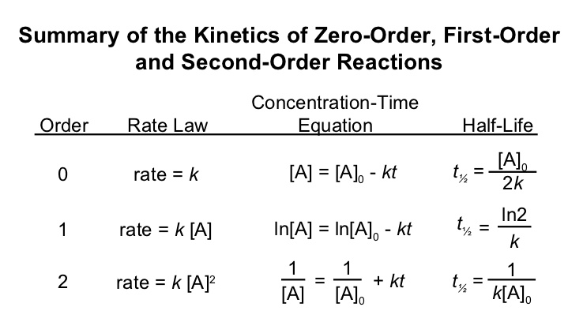
Reactant Concentration and Time
General rate law:
Relates rate and concentration via rate constant.
Tells you the order of the reaction.
Rate constant is good for comparing different reactions.
Can also be used, with minor modification, to predict concentrations at any time and vice versa!
Ch 13.3
Page 577

Slide 39
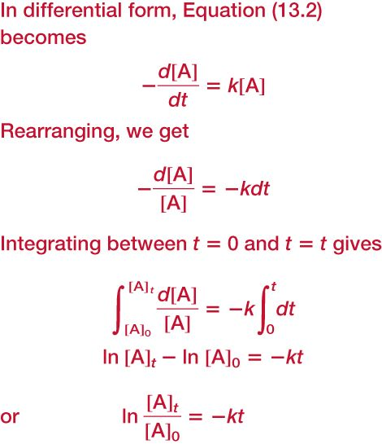


First Order Reactions
Rate law can also be used, with minor modification, to predict concentrations at any time and vice versa!
A B
Reaction rate:
Rate Law:
Δ[A]
rate = -
rate = k [A]
Δt
Δ[A]
-
= k [A]
Δt
Calculus Happens!
or

Slide 40
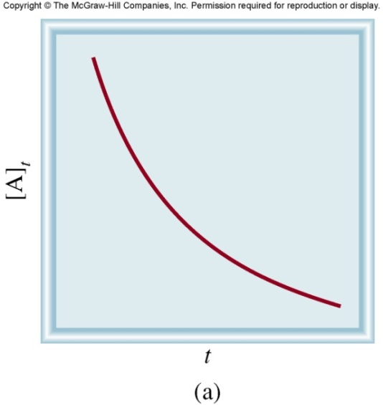
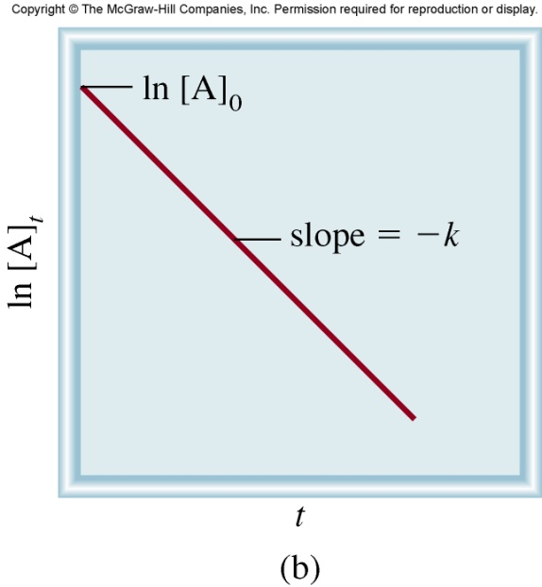
First Order Reactions
or
t is time
[A]_{t} is the concentration of A at any time t
[A]₀ is the concentration of A at time t=0
k is the rate constant
y = m • x + b
ln[A]_{t} = -k • t + ln[A]₀
Know [A]₀ and t, predict [A]_{t}
Know [A]₀ and [A]_{t}, predict t
Know [A]_{t} and t, predict [A]₀

Slide 41
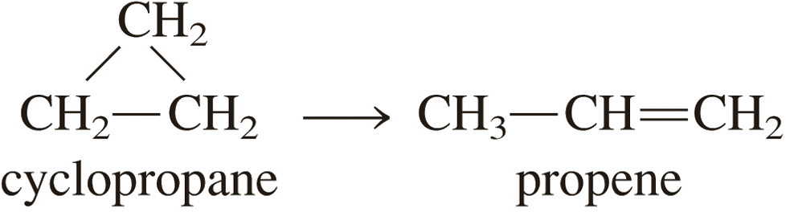
13.4
The conversion of cyclopropane to propene in the gas phase is a first-order reaction with a rate constant of 6.7 × 10⁻⁴ s⁻¹ at 500°C.
If the initial concentration of cyclopropane was 0.25 M, what is the concentration after 8.8 min?
How long (in minutes) will it take for the concentration of cyclopropane to decrease from 0.25 M to 0.15 M?
How long (in minutes) will it take to convert 74 percent of the starting material?
ln[A]_{t} = -k • t + ln[A]₀
Know k. Given [A]₀ and t. Find [A]_{t}.
Know k. Given [A]₀ and [A]_{t}. Find t.
Know k. Given [A]₀ and [A]_{t}. Find t.

Slide 42
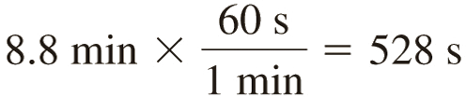
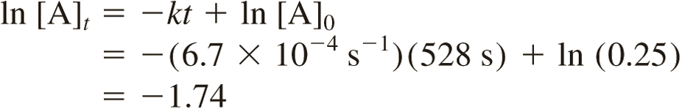

13.4
Solution (a) If the initial concentration of cyclopropane was 0.25 M, what is the concentration after 8.8 min? (k = 6.7 × 10⁻⁴ s⁻¹)
Know k. Given [A]₀ and t. Find [A]_{t}.

Slide 43
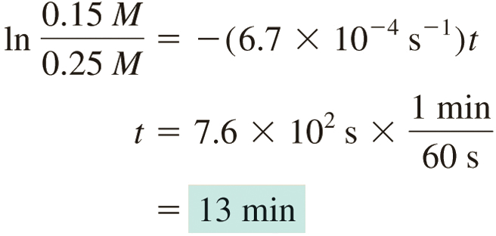
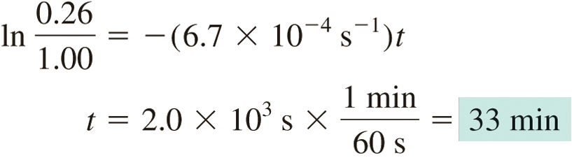
13.4
or
(b) How long (in minutes) will it take for the concentration of cyclopropane to decrease from 0.25 M to 0.15 M? (k = 6.7 × 10⁻⁴ s⁻¹)
(c) How long (in minutes) will it take to convert 74 percent of the starting material? (k = 6.7 × 10⁻⁴ s⁻¹)
Know k. Given [A]₀ and [A]_{t}. Find t.
Know k. Given [A]₀ and [A]_{t}. Find t.

Slide 44
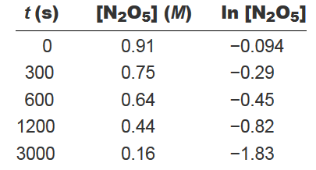
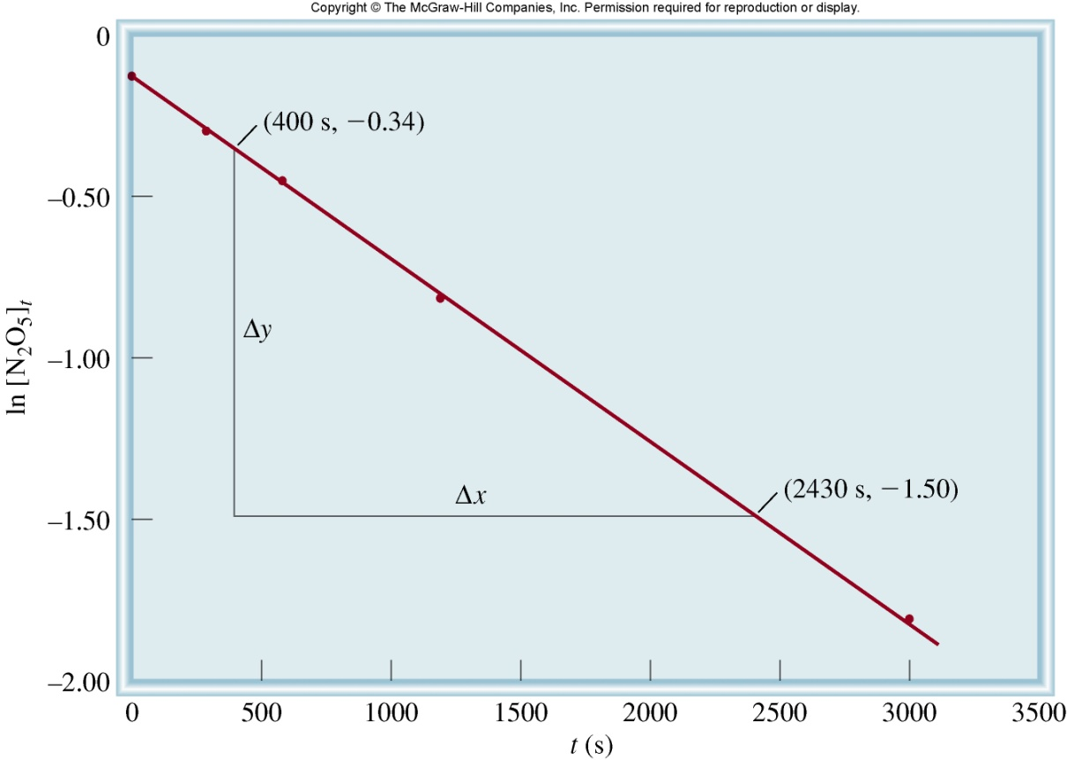
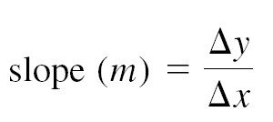


Determination of k
Earlier we found k by graphing Rate vs [conc]
rate = k [Br₂]
But you have to calc rate at each [conc] and then find the slope.
2N₂O₅ 4NO₂ (g) + O₂ (g)
y = m • x + b
ln[A]_{t} = -k • t + ln[A]₀
Measure concentration with time.
Graph date.
Math.

Slide 45
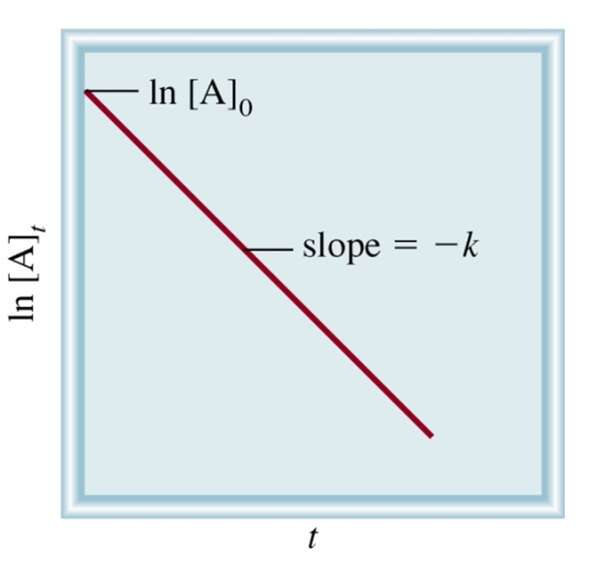
First Order Half-life
y = m • x + b
ln[A]_{t} = -k • t + ln[A]₀
ln[A]_{t}
= -k • t
ln[A]₀
Half-life (t_{½})-the time required for the concentration of a reactant to decrease to half of its initial concentration.
t_{½} = t when [A]_{t} = [A]₀/2
[A]₀
ln
[A]₀/2
ln 2
t_{½}
=
0.693
t_{½}
=
=
=
0.693
k
k
k
k
Ch 13.3
Page 582

Slide 46

First Order Half-life
t_{½}
=
0.693
k
# of
half-lives
[A] = [A]₀/n
1
2
2
4
3
8
4
16
First order half-life is concentration independent!

Slide 47
Radioactive decay as 1st order rxns
Many radioactive decay processes are first order…
half-life of 8.04 days
half-life of 5730 yrs
half-life of 4.51 x 10⁹ yrs
Radiometric Dating-
An error margin of 2–5% has been achieved on dating younger Mesozoic rocks (252-266 million years old). Typically with uranium doped ZrSiO₄.
²³⁸U to ²⁰⁶Pb
¹⁴C radiometric dating.
Ratio of ¹⁴C to ¹²C

Slide 48


13.6
The decomposition of ethane (C₂H₆) to methyl radicals is a first-order reaction with a rate constant of 5.36 × 10⁻⁴ s⁻¹ at 700°C:
Calculate the half-life of the reaction in minutes.

Slide 49

Second Order Reactions
Rate law can also be used, with minor modification, to predict concentrations at any time and vice versa!
A + A B
Reaction rate:
Rate Law:
Δ[A]
rate = -
rate = k [A]²
Δt
Δ[A]
-
= k [A]²
Δt
Second Order
Half-life
Calculus Happens!
1
=
kt +
1
[A]
[A]₀

Slide 50

Second Order Reactions
1
=
kt +
1
[A]
[A]₀
t is time
[A]_{t} is the concentration of A at any time t
[A]₀ is the concentration of A at time t=0
k is the rate constant
y = m • x + b
1
=
kt +
1
[A]
[A]₀
Know [A]₀ and t, predict [A]_{t}
Know [A]₀ and [A]_{t}, predict t
Know [A]_{t} and t, predict [A]₀

Slide 51


13.7
Iodine atoms combine to form molecular iodine in the gas phase
This reaction follows second-order kinetics and has the high rate constant 7.0 × 10⁹/M · s at 23°C.
If the initial concentration of I was 0.086 M, calculate the concentration after 2.0 min.
Calculate the half-life of the reaction if the initial concentration of I is 0.60 M, 0.42 M.
1
=
kt +
1
Know k. Given [A]₀ and t. Find [A]_{t}.
[A]
[A]₀
Know k. Given [A]₀. Find t.

Slide 52


13.7
Iodine atoms combine to form molecular iodine in the gas phase
This reaction follows second-order kinetics and has the high rate constant 7.0 × 10⁹/M · s at 23°C.
If the initial concentration of I was 0.086 M, calculate the concentration after 2.0 min.
Know k. Given [A]₀ and t. Find [A]_{t}.

Slide 53


13.7
Iodine atoms combine to form molecular iodine in the gas phase
This reaction follows second-order kinetics and has the high rate constant
7.0 × 10⁹/M · s at 23°C.
(b) Calculate the half-life of the reaction if the initial conc of I is 0.60 M, 0.42 M.
Know k. Given [A]₀. Find t.
[A]₀ = 0.60 M
[A]₀ = 0.42 M
Second order half-life is concentration dependent!

Slide 54
Chapter 13
Ch 13
Page 564

Slide 55
General Reaction Rate Expression
For a general reaction:
the reaction rate can be expressed as
aA + bB ⎯→ cC + dD
Ch 13.1
Page 571

Slide 56
Determining Rate Laws (by inspection)
F₂ (g) + 2ClO₂ (g) 2FClO₂ (g)
Vary concentrations.
Measure rate.
Tabulate the data.
rate = k [F₂]^{x}[ClO₂]^{y}
Comparing rxn 1 and 2:
[F₂] constant, [ClO₂] quadruples, rate quadruples
rate α [ClO₂]
y = 1
Comparing rxn 1 and 3:
[ClO₂] constant, [F₂] doubles, rate doubles
Ch 13.2
Page 573
rate α [F₂]
x = 1

Slide 57
Reaction Order
aA + bB ⎯→ cC + dD
The rate law for a general reaction takes the form:
Reaction order- specify the relationship between the concentrations of reactants A and B and the reaction rate.
Reaction is xth order in A
Reaction is yth order in B
Reaction is (x +y)th order overall
If a reagent is zero order it is not included in the rate law.
Helps to explain the mechanism of the reaction. Order tells you what molecules are involved in the rate limiting step and how of each molecule are needed.
Ch 13.2
Page 573

Slide 58
First Order Reactions
or
t is time
[A]_{t} is the concentration of A at any time t
t_{½}
=
0.693
[A]₀ is the concentration of A at time t=0
k
k is the rate constant
y = m • x + b
ln[A]_{t} = -k • t + ln[A]₀
Know [A]₀ and t, predict [A]_{t}
Know [A]₀ and [A]_{t}, predict t
Know [A]_{t} and t, predict [A]₀

Slide 59
Second Order Reactions
1
=
kt +
1
[A]
[A]₀
Second Order
Half-life
t is time
[A]_{t} is the concentration of A at any time t
[A]₀ is the concentration of A at time t=0
k is the rate constant
y = m • x + b
1
=
kt +
1
[A]
[A]₀
Know [A]₀ and t, predict [A]_{t}
Know [A]₀ and [A]_{t}, predict t
Know [A]_{t} and t, predict [A]₀

Slide 60



First and Second Order Reactions
rate = k [A]
rate = k [A]²
First Order Reaction
Second Order Reaction
ln[A]_{t} = -k • t + ln[A]₀
1
1
=
kt +
[A]
[A]₀

Slide 61
Side note: Psuedo First Order Kinetics
Sometimes a second order reaction can appear, either intentionally or inadvertently, as a first order reaction (AKA psuedo first order kinetics).
A + B C
Exp | [A] | [B] | Initial rate
a | 1.0 | 1.0 | 2.0 x 10⁻⁴
b | 2.0 | 1.0 | 4.0 x 10⁻⁴
c | 1.0 | 2.0 | 4.0 x 10⁻⁴
Exp | [A] | [B] | Initial rate
a | 1.0 | 1000000 | 2.0 x 10⁻⁴
b | 2.0 | 1000000 | 4.0 x 10⁻⁴
c | 1.0 | 2000000 | 2.0 x 10⁻⁴
Rate = k [A][B]
Rate = k [A]
  Since [B] >>>> [A]
  [B] doesn’t change during the reaction
  The reaction is really second order but appears first order.

Slide 62
Pseudo-first Order Reaction
Example hydration of methyl iodide (SN2 reaction)
If we carry out the reaction in aqueous solution
  [H₂O] >>>> [CH₃I] ∴ [H₂O] doesn’t change
    CH₃I(aq) + H₂O(l) → CH₃OH(aq) + H⁺(aq) + I⁻(aq)
Rate = k [CH₃I] [H₂O]
Rate = k [CH₃I]

Slide 63
Zero Order Reactions
Independent of the concentration of starting material!
A B
Reaction rate:
Rate Law:
Δ[A]
rate = -
rate = k [A]⁰
Δt
rate = k
Δ[A]
-
= k
Δt
Calculus Happens!
[A]_{t} = -k • t + [A]₀

Slide 64

Zero Order Reactions
Independent of the concentration of starting material!
[A]_{t} = -k • t + [A]₀
t is time
[A]_{t} is the concentration of A at any time t
[A]₀ is the concentration of A at time t=0
k is the rate constant
y = m • x + b
[A]_{t} = -k • t + [A]₀
Know [A]₀ and t, predict [A]_{t}
Know [A]₀ and [A]_{t}, predict t
Know [A]_{t} and t, predict [A]₀

Slide 65



Zero Order Reaction Example
The amount of drug eliminated for each time interval is constant ,regardless of the amount in the body.
Rate | Amount of drug eliminated (mg) | Amount of drug in the body (mg) | Time (min)
 | - | 1000 | 0
100 mg/min | 100 | 900 | 1
100 mg/min | 100 | 800 | 2
100 mg/min | 100 | 700 | 3
100 mg/min | 100 | 600 | 4
100 mg/min | 100 | 500 | 5
100 mg/min | 100 | 400 | 6
rate = k [A]⁰
rate = k
Enzyme as a catalyst.
The slow step.

Slide 66

Zero Order Reaction Example
rate = k [NH₃]⁰ = k (1) = k = constant

Slide 67
Summary
Concentration-Time
Equation
Order
Rate Law
Units on k
Half-Life
[A]₀
0
rate = k
M s⁻¹
[A] = [A]₀ - kt
t_{½} =
2k
ln 2
1
rate = k [A]
s⁻¹
ln[A] = ln[A]₀ - kt
t_{½}
=
k
1
1
1
2
rate = k [A]²
M⁻¹ s⁻¹
=
+ kt
t_{½} =
[A]
[A]₀
k[A]₀

Slide 68
Summary
rate = k
rate = k [A]
rate = k [A]²
Zero Order Reaction
First Order Reaction
Second Order Reaction
[A]_{t} = -k • t + [A]₀
ln[A]_{t} = -k • t + ln[A]₀
1
1
=
kt +
[A]
[A]₀

Slide 69




Side note: Third Order Kinetics
Rare and typically slow!
One possibility for the mechanism of this reaction would be a three-body collision (i.e. a true termolecular reaction).

Slide 70



Experimental Kinetics
Set up the reaction.
Measure concentration change over time.
Graph the result
Find the graph that generates a straight line.
Zero Order Reaction
First Order Reaction
Second Order Reaction
[A]_{t} = -k • t + [A]₀
ln[A]_{t} = -k • t + ln[A]₀
1
1
=
kt +
[A]
[A]₀

Slide 71



Experimental Kinetics
Experiment 1:
Experiment 2:
Experiment 3:

Slide 72
Chapter 13
Ch 13.3
Page 577

